Slide 1

MONTHLY REPORT – AUGUST 2026
ENTERPRISE FINANCIAL SYSTEM
DIVISI IT APPLICATION SERVICES
2026

Slide 2

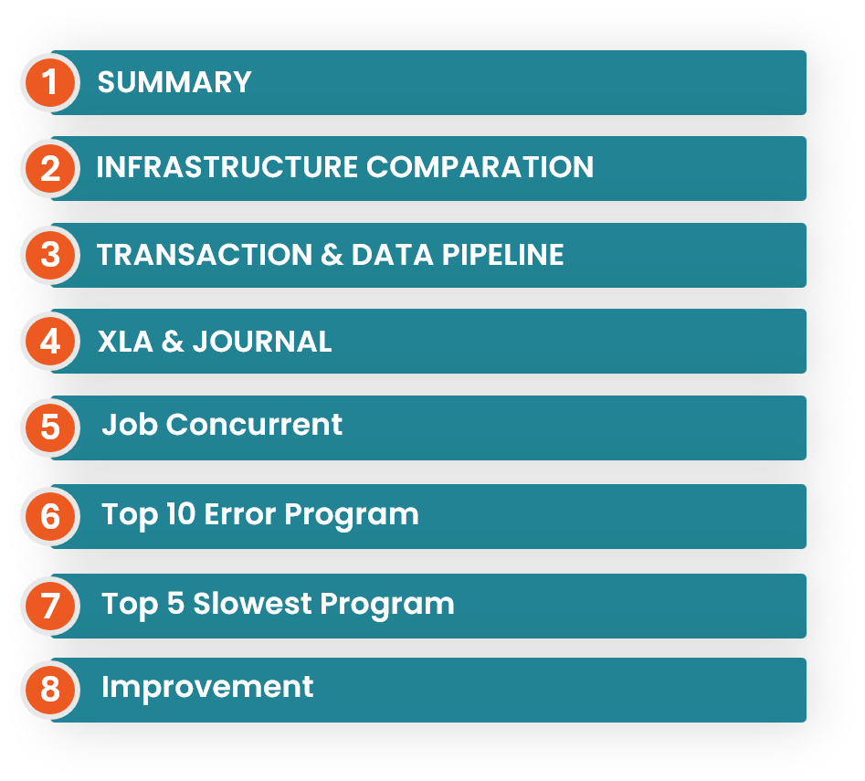
AGENDA

Slide 3


01
Summary: August Remained Critical, dengan Perbaikan XLA
7 / 8 > Juli (Worse)
94,76% > Juli (Healthier)
6 < Juli (Healthier)
+138% > Juli (Increasing)
1.034.245 < Juli (Healthier)
Host Critical
XLA Processed
XLA Error
XLA Unprocess
Create Accounting
Naik dari 7 Critical + 1 Warning pada August.
Naik dari baseline success 98,68% pada August.
XLA event status membaik dari 232.394 error pada bulan Juli menjadi 0.
XLA Unprocessed peak Agustus; lebih rendah dari peak Juli sebesar 450.007 hits.
Volume naik 21.273 menjadi 50.697 hits dibandingkan bulan Juli lalu
Critical Findings yang membutuhkan perhatian
Overall Status
Infrastructure memburuk: efsdbslp02 berubah dari Warning → Critical, sedangkan efsdbsdr01 bergeser dari disk issue menjadi CPU issue.
CRITICAL
Pipeline volume meningkat tajam. Journal Import membaik, tetapi untuk Job Accounting Program, FAH Process, dan Report Set mengalami kenaikan P99.
Primary drivers
XLA membaik secara kualitas: tidak ada error pada Agustus. Risiko tersisa adalah residual akhir bulan pada 23 dan 31 Agustus.
Recurring CPU saturation
Pipeline latency
Month-end residual
CPU saturation berulang: ebsintslp02 pada 6, 9, 11 Agustus; efsdbsdr01 pada 4, 6, 7, 27 Agustus; efsdbslp01 pada 18 hari; efsdbslp02 pada 11 hari. Peak CPU Load ebsintslp01 terjadi 30 Agustus, dikarenakan terdapat Job Gather Schema Statistic.​
EFS Monthly Health Report | Agustus 2026 | Confidential
1
Notes:
[Sources]
- EFS_Infrastructures_June.xlsx and EFS_Infrastructures_July.xlsx
- EFS_Transactions_June.xlsx and EFS_Transactions_July.xlsx
- EFS Monthly Report PPTX.pptx for June XLA baseline
- EFS_XLA_July.xlsx
[/Sources]

Slide 4
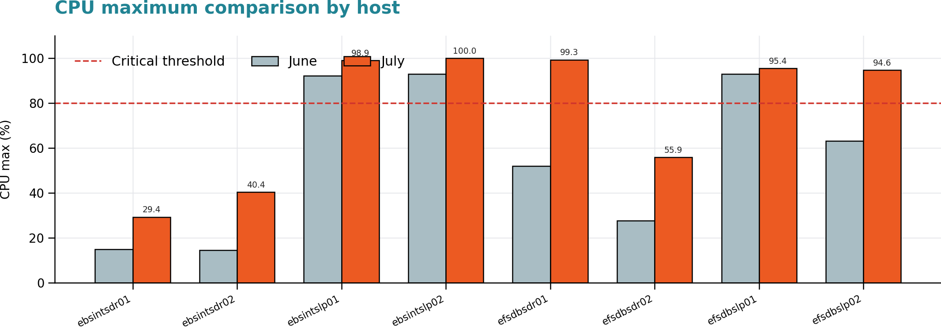
02
Infrastructure Comparation: Juli vs Agustus 2026
Host | Juli | Agustus | Δ CPU | Peak / Finding Agustus
ebsintslp01 | Critical | Critical | +6,69 | 98,94% | 30 Jul
ebsintslp02 | Critical | Critical | +7,00 | 100% | 9 Jul
efsdbsdr01 | Critical* | Critical | +47,31 | 99,31% | 4 Jul
efsdbslp01 | Critical | Critical | +2,44 | 95,44% | 13 Jul
efsdbslp02 | Warning | Critical | +31,52 | 94,62% | 30 Jul
Monitoring menunjukan efsdbsdr01: disk membaik 82,25% → 68,09%, tetapi MAX CPU naik 52,00% menjadi 99,31% pada tanggal 4 Agustus menyentuh Critical threshold
Memory seluruh host tetap <70%, sehingga bukan bottleneck utama.
Server efsdbslp02 mengalami kenaikan CPU, Dimana pada bulan Juli berstatus Warning dimana max CPU berada di 63,1% namun pada bulan Agustus max CPU mencapai angka Critical yaitu 94,62% pada tanggal 30 Agustus
* Juli: efsdbsdr01 Critical karena disk; Agustus: Critical karena CPU.
Verdict: Degraded. Jumlah host Critical meningkat dan CPU spike meluas ke database tier.
EFS Monthly Health Report | Agustus 2026 | Confidential
2
Notes:
[Sources]
- EFS_Infrastructures_June.xlsx, Monthly Summary and Max CPU Usage
- EFS_Infrastructures_July.xlsx, Monthly Summary and Max CPU Usage
[/Sources]

Slide 5
02
Infrastructure Detail
CPU (Max)
<60% (Healthy) / 60–80% (Warning) / >80% (Critical)
Memory (Max)
<70% (Healthy) / 70–90% (Warning) / >90% (Critical)
Disk (Max)
<60% (Healthy) / 60–80% (Warning) / >80% (Critical)
Host | Peran | CPU Avg | CPU Max | CPU Min | Memory Avg | Memory Max | Memory Min | Disk Avg | Disk Max | Disk Min | Status
ebsintsdr01 | DR App | 2,86% | 29,35% | 1,20% | 7,91% | 23,87% | 6,90% | 20,84% | 23,26% | 16,75% | Healthy
ebsintsdr02 | DR App | 2,66% | 40,36% | 1,77% | 8,07% | 20,22% | 6,81% | 12,17% | 15,50% | 0,00% | Healthy
ebsintslp01 | DC App | 17,84% | 98,94% | 3,58% | 46,95% | 58,36% | 30,62% | 20,73% | 27,13% | 17,64% | Critical
ebsintslp02 | DC App | 15,04% | 100,00% | 4,10% | 41,64% | 52,79% | 24,76% | 10,01% | 14,96% | 0,00% | Critical
efsdbsdr01 | DR DB | 39,23% | 99,31% | 1,48% | 55,56% | 63,89% | 13,92% | 66,76% | 68,09% | 65,02% | Critical
efsdbsdr02 | DR DB | 8,23% | 55,86% | 1,52% | 48,83% | 51,16% | 17,20% | 46,72% | 47,86% | 45,28% | Healthy
efsdbslp01 | DC DB | 39,35% | 95,44% | 0,00% | 51,44% | 60,88% | 0,00% | 60,64% | 73,49% | 0,00% | Critical
efsdbslp02 | DC DB | 39,28% | 94,62% | 0,00% | 51,72% | 62,33% | 0,00% | 58,84% | 59,36% | 0,00% | Critical
EFS Monthly Health Report | Agustus 2026 | Confidential
2
Notes:
[Sources]
- EFS_Infrastructures_June.xlsx, Monthly Summary and Max CPU Usage
- EFS_Infrastructures_July.xlsx, Monthly Summary and Max CPU Usage
[/Sources]

Slide 6
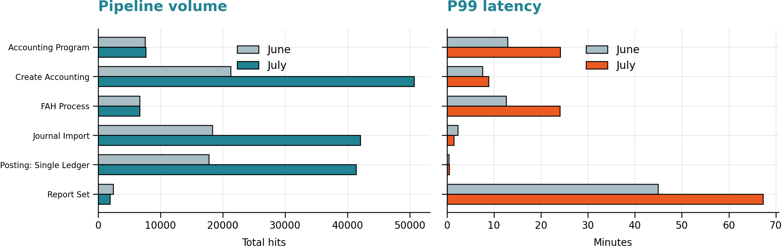
03
Transaction & Data Pipeline: Komparasi Juli vs Agustus
Key Changes
Create Accounting hits +138%; P99 naik 7,53 → 8,90 menit.
Journal Import hits +129%; P99 membaik 2,32 → 1,44 menit.
Accounting Program P99 naik 12,87 → 24,09 menit; peak 29 Agustus 30,81 menit.
FAH Process P99 naik 12,61 → 24,05 menit.
Report Set P99 naik 44,94 → 67,27 menit; peak 2 Agustus 105,27 menit.
Terjadi kenaikan segnifikan terhadap P99 Latency dan Pipeline volume, hal ini dikarenakan program EFS pada Wave 3 telah sepenuhnya berjalan di environtment production
XLA event Unprocessed pada end terpantau membaik dibandingkan bulan Juli lalu
EFS Monthly Health Report | Agustus 2026 | Confidential
3
Notes:
[Sources]
- EFS_Transactions_June.xlsx and EFS_Transactions_July.xlsx, Summary and Response Time P99
- EFS Monthly Report PPTX.pptx, June XLA baseline
- EFS_XLA_July.xlsx, Summary and Daily Trend
[/Sources]

Slide 7
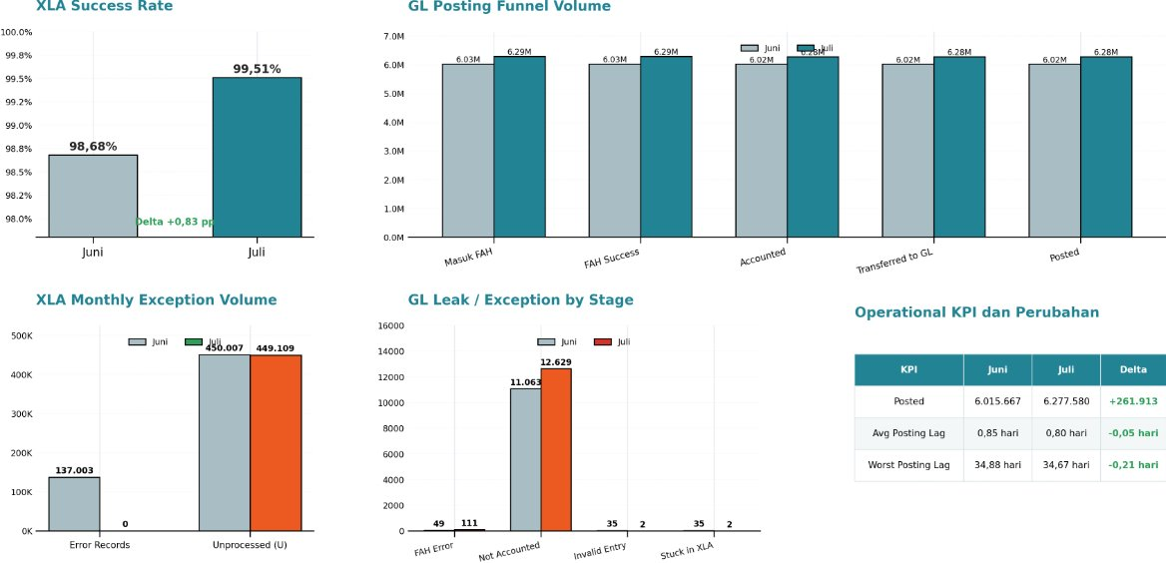
04
XLA dan Journal Posted: Juli vs Agustus
Key Changes
Total posted naik 261.913 record atau 4,35%, dari 6.015.667 menjadi 6.277.580.
Stuck in XLA dan invalid accounting entry membaik dari masing-masing 35 menjadi 2 record
FAH Error meningkat dari 49 menjadi 111 record dan proses Accounting yang bersatus = Draft meningkat dari 11.063 menjadi 12.629 record
Rata-rata posting lag membaik dari 0,85 hari menjadi 0,80 hari, sedangkan worst lag relatif stabil dari 34,88 menjadi 34,67 hari.
Rata-rata posting lag (selisih) membaik dari 0,85 hari menjadi 0,80 hari, sedangkan worst lag relatif stabil dari 34,88 menjadi 34,67 hari.
*Posting lag = selisih hari antara accounting date transaksi dan tanggal jurnalnya berstatus Posted di GL. Rata-rata menggambarkan kondisi mayoritas record; worst lag menunjukkan record tertua yang belum ter-post.
EFS Monthly Health Report | Agustus 2026 | Confidential
3
Notes:
[Sources]
- EFS_Transactions_June.xlsx and EFS_Transactions_July.xlsx, Summary and Response Time P99
- EFS Monthly Report PPTX.pptx, June XLA baseline
- EFS_XLA_July.xlsx, Summary and Daily Trend
[/Sources]

Slide 8

04
Status Data (XLA): Breakdown & SLO
Service Level Objective (SLO): Success Rate (XLA=S) ≥ 99,5% | Error Rate (XLA=E) ≤ 1% | Backlog (U/V) ≤ 1% volume harian
Status Data | Jumlah Baris | % Total | Makna | SLO
Clean / Success (XLA=S) | 70.193.807 | 94,76% | Accounting entry berhasil dibuat. Tidak terdapat XLA Error; success rate melampaui target SLO 99,5%. | Healthy
Validation (XLA=V) | 346.723 | 0,49% | Data tervalidasi namun jurnal final belum terbentuk sepenuhnya. | Warning
Unprocessed (EVS=U) | 1.034.245 | 0,64% | Residual queue / final sweep masih pending. Terkonsentrasi pada tanggal 31 Agustus (1.034.245 baris). | Warning
Error (XLA=E) | 6 | 0,00% | Invalid event, tidak terdapat XLA Error maupun Related Event Error. | Healthy
TOTAL (30 hari) | 70.540.530 | 100% | Volume transaksi XLA selama Agustus 2026. | -
a. Healthy Day
b. Unprocessed: Tindakan
31/31 hari memenuhi target Success Rate ≥ 99,5%.
Success Rate bulanan mencapai 94,76%, Error Rate 0,00%, dan backlog 0,64% masih berada di bawah batas SLO 1%
Residual Unprocessed mencapai 1.034.245 baris (0,64%), dengan konsentrasi tertinggi pada 31 Agustus sebesar 321.564 baris. Diperlukan final sweep dan rekonsiliasi untuk mengurangi backlog akhir bulan. Rekomendasi: monitoring harian residual serta penjadwalan final sweep yang konsisten agar backlog tetap di bawah ambang SLO 1%
EFS Monthly Health Report | August 2026 | Confidential

Slide 9
05
Job Concurrent
Healthy = P99 < SLO
Warning = P99 1-2x SLO
Critical = P99 > 2x SLO
Program Name | Avg(min) | P99(min) | RPH | Total Hit | Success Rate (%) | Error Rate (%) | SLO | Status
BNI GL Interface Kurs Harian | 0.8 | 2.98 | 0.06 | 45 | 92.5 | 7.5 | 3 | Healthy
Update Subledger Accounting Balances | 0.19 | 1.61 | 5.72 | 4257 | 99.98 | 0.02 | 3 | Healthy
Posting: Single Ledger | 0.17 | 1.18 | 65.6 | 48808 | 99.99 | 0.01 | 2 | Healthy
BNI FAH Laporan Konfigurasi | 0.55 | 0.72 | 0 | 3 | 100 | 0 | 180 | Healthy
Validate Application Accounting Definitions | 39.16 | 188.49 | 0.02 | 17 | 94.12 | 5.88 | 180 | Warning
Posting | 0.51 | 2.19 | 0.17 | 125 | 100 | 0 | 2 | Warning
Report Set | 33.09 | 453.45 | 2.58 | 1921 | 54.14 | 1.05 | 80 | Critical
Journal Import | 0.23 | 11.01 | 65.65 | 48843 | 99.93 | 0.01 | 2 | Critical
BNI FAH Journal Reversal | 30.89 | 263.76 | 0.06 | 44 | 100 | 0 | 30 | Critical
Transfer Journal Entries to GL | 3.62 | 46.72 | 0.19 | 141 | 96.3 | 1.48 | 5 | Critical
FAH Process | 4.67 | 49.19 | 10.55 | 7846 | 99.99 | 0.01 | 5 | Critical
Create Accounting | 2.15 | 43.02 | 68.2 | 50741 | 92.73 | 0.19 | 3 | Critical
Accounting Program | 5.27 | 50.72 | 11.89 | 8843 | 53.44 | 0.43 | 3 | Critical
BNI GL Laporan Jurnal Transaksi per Entity V2 | 21.15 | 519.99 | 0.95 | 704 | 95.58 | 1 | 30 | Critical
Depreciation Run* | 22.75 | 622.78 | 0.12 | 89 | 98.88 | 1.12 | 30 | Critical
Gather Schema Statistics | 141.77 | 708.47 | 0.11 | 81 | 98.41 | 0 | 20 | Critical
EFS Monthly Health Report | Agustus 2026 | Confidential
2
Notes:
[Sources]
- EFS_Infrastructures_June.xlsx, Monthly Summary and Max CPU Usage
- EFS_Infrastructures_July.xlsx, Monthly Summary and Max CPU Usage
[/Sources]

Slide 10
06
Top 10 Error: Program Job (Genuine Errors)
# | Program | Error | Status / Penyebab | Workaround | Perm. Fix
1 | Create Accounting | 96 | ORA-0000: normal, successful completion (error on child program) | Cek log, identifikasi request gagal, submit ulang manual via EBS (SystemEFS→ Requests → Submit) | -
2 | Accounting Program | 38 | 20x ValidateAAD ORA-0000; 16x EventClass_349 ORA-01403 no data found; 2x lainnya | Submit ulang secara manual di EBS dengan responsibility FAH; untuk ORA-01403 cek reference data EventClass_349 | -
3 | Report Set | 20 | 18x outcome Error stage Mass Additions Post; 1x stage Depreciation Run; 1x no reason | Submit ulang Report Set secara manual; verifikasi stage penyebab via log | -
4 | Journal Import | 7 | Program exited status 1; GLLEZL process exiting with failure | - | -
5 | Posting: Single Ledger | 6 | 3x no reason for failure; 3x exited status 1 | Submit ulang Posting manual via GL Super User → Journals → Post (Jika Postable)
6 | BNI GL Interface Kurs Harian | 3 | Concurrent Manager gagal start immediate program (XXCUST_GL_DAILY_RATES) | Submit ulang secara manual;, BNI GL Interface Kurs Harian | Jadwalkan scheduler ulang dari pukul 18.00 menjadi 18.30
7 | Transfer Journal Entries to GL | 2 | ORA-06502: PL/SQL numeric or value error; character string buffer too small | - | -
8 | FAH Process | 1 | Concurrent program returned no reason for failure | Submit ulang secara manual via EBS | -
9 | BNI GL Lap. Jurnal Trx Entity V2 | 1 | Concurrent program returned no reason for failure | - | -
10 | Update Subledger Acct Balances | 1 | Concurrent program returned no reason for failure | - | -
EFS Monthly Health Report | August 2026 | Confidential

Slide 11
07
Top 5 Slowest Program: Response Time (P95)
# | Program | P95 (min) | P99 (min) | Total Hit | Total Error | Durasi Normal | Status
1 | Report Set | 63,20 | 67,30 | 1907 | 20 | 80 mnt | Healthy
2 | Validate App Acct Definitions | 39,19 | 39,19 | 17 | 1 | 180 mnt | Healthy
3 | BNI GL Lap. Jurnal Trx Entity V2 | 28,40 | 29,39 | 681 | 1 | 30 mnt | Healthy
4 | BNI FAH Journal Reversal | 28,15 | 28,15 | 41 | 0 | 30 mnt | Healthy
5 | Accounting Program | 23,23 | 24,09 | 7609 | 38 | 3 mnt | Critical
EFS Monthly Health Report | August 2026 | Confidential

Slide 12
08
Improvement: Observed Gains dan Required Actions
Observed Improvements
Required Actions
Priority | Action | Required Evidence | Owner
P1 | Re-Capacity Plan (On-Progress) | Trend CPU 2-3 bulan per host Critical; hasil sizing kebutuhan core tambahan; timeline procurement dan implementasi; validasi CPU <80% pasca upgrade. | DBA, IFM, APP
P1 | XLA drain control | Konfirmasi residual pasca 31 Jul; alert >1% volume harian; deterministic sweep. | DBA, APP
P1 | Accounting RCA | Map ValidateAAD / ORA-01403 ke event class dan source data. | User, APP
P1 | CPU correlation | Overlay concurrent request, DB session, dan CPU timestamp pada tanggal peak. | DBA, APP
P2 | Gathering GL Posted & Unposted (On-Going) | Konfirmasi dan diskusi dengan developer data apa yang dibutuhkan untuk memastikan bahwa sudah Posted atau masih Unposted | Apps / Dev
232.394 → 0
82,25% → 68,09%
XLA Error
Disk efsdbsdr01
Improvement pada XLA event status dari Juli ke Agustus, tidak ada XLA Error
Capacity condition terpantau membaik.dibandingkan bulan Juli
2,32 → 1,44 min
450.007 → 1.034.245
Journal Import P99
Peak XLA Residual
Latency membaik meski volume transaksi naik +129% pada bulan Agustus. (slide 5)
Peak lebih rendah, namun terjadi saat month-end. (slide 5)
Success criteria next month
Tidak ada recurring CPU spike tanpa RCA; XLA residual ter-drain; telemetry lengkap; exception pipeline memiliki owner dan closure evidence.
EFS Monthly Health Report | Agustus 2026 | Confidential
5
Notes:
[Sources]
- Observed improvements calculated from June and July infrastructure, transaction, and XLA monthly data
- Required actions are proposed management follow-ups based on July findings
[/Sources]

